Slide 1
Wamalloc: An Efficient Wear-Aware Allocator for Non-Volatile Memory
Jiashun Zhu, Sumin Li, Linpeng Huang
Department of Computer Science and Engineering
Shanghai Jiao Tong University
Notes:
Hi, my name is Zhujiashun, and I comes from shanghai jiaotong university.
The topic I am going to talk about is about an Efficient Wear-Aware Allocator for Non-Volatile Memory

Slide 2
Content
Introduction
Motivations
Design and implementation of Wamalloc
Evaluation
Conclusion
Notes:
First I will talk about some introduction and background in NVM and our motivation for a new memory allocator for NVM.
Then, I will go deep into design and implementation of wamalloc.
After that, I will show the performance of Wamalloc and reach our conclusion.

Slide 3
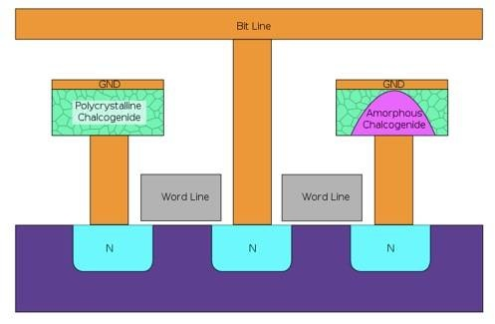
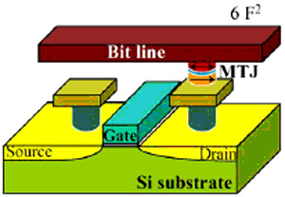
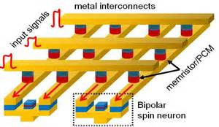
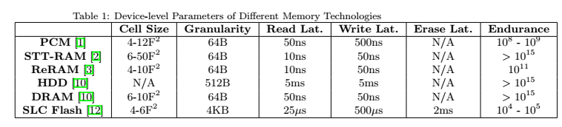
Emerging NVM Technology
PCM
STT-RAM
ReRAM
Key Features
Byte addressability
Comparable access speed as DRAM
Notes:
For decades, DRAM has been used as the main memory of computer system. However, with the great demands of performance and energy-constrain applications, the defects of DRAM have become a main concern, for example, the limited density and its high energy consumption. Fortunately, an emerging new technology named non-volatile memory provides the solution to address these problems. NVM has the advantages of high density, low power consumption and byte-addressable, which make it a better alternative to be the main memory when compared with DRAM.
However, NVM suffers from limited write endurance. For example, a typical PCM cell permanently fails after nearly ten to the power of seven to ten to the power of nine writes.
In such a circumstance, a poorly designed memory allocator will break the PCM in a short time. For purpose of tackling this problem and support a software level wear-aware memory allocator, a new memory allocator must be designed for applications running on NVM.

Slide 4
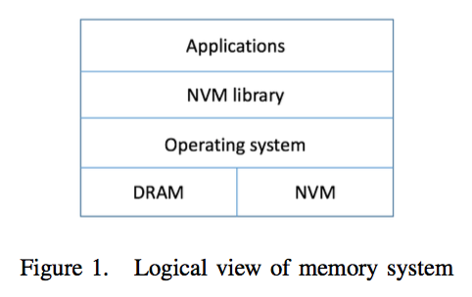
NVM in Memory System
Notes:
Due to the limitations, NVM is not likely to replace DRAM as the only main mem- ory in computer system. We assume that at least for write- intensive applications, a combination of DRAM and NVM should be used in computer systems, taking their respective advantages.
Here is the logical view of the hybrid memory system .

Slide 5
Motivation for a New Allocator for NVM
Memory Allocators have been a key component of system software, making a significant impact on system performance
The unique features of emerging NVM bring new opportunities for Memory Allocators:
Very high access speed
Wear Leveling issues
There are a number of existing memory allocators for NVM, but they have limitations.
None of the current allocators can provide both an accurate wear-leveling policy and a good allocation performance simultaneously.
Notes:
Memory Allocators have been a key component of system software, making a significant impact on system performance.
The unique features of emerging NVM bring new opportunities for Memory allocators. It can provide very high access speed, which is a good property, however it suffers from wear-leveling problem, which means it can be quickly damaged if a bad memory allocator running upon it.
There are a number of existing memory allocators for NVM, but they all have some kind of limitations! We will compare them more deeply in the next slide.
None of the current allocators can provide both an accurate wear-leveling policy and a good allocation performance simultaneously.

Slide 6
Motivation for a New In-Memory File System (Cont’)
Larger number means poorer performance
Systems | Allocation performance | Wear-leveling | Total Memory Usage
NVMalloc | 1(not fast enough) | Support(not good enough) | high
nvm_malloc | 2 | N/A | high
pmemalloc | 3 | N/A | high
Wamalloc | Expected to be the best | Expected to be the best | Expected to be the best
Notes:
The table shows the detail comparison between nowadays state-of-the-art nvm allocators.
We can see that NVMalloc is the best in these allocators, but our experiment shows that the overall performance and wear-leveling policy is not good enough. So it motivates us to write a better allocator.

Slide 7
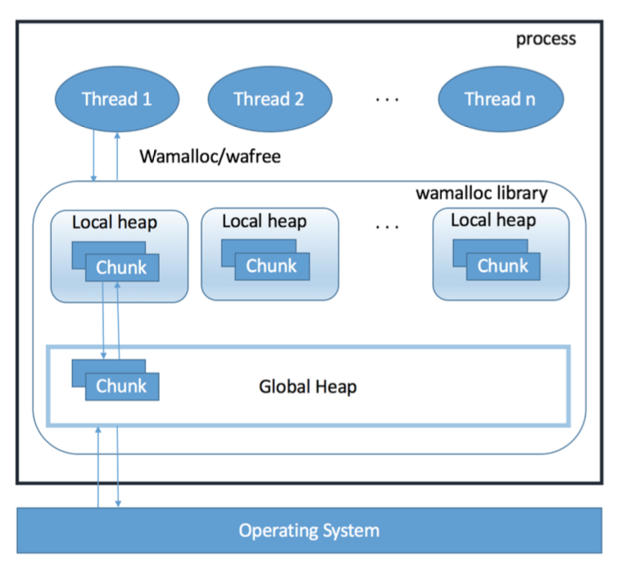
Design of Wamalloc
Desgin Principles:
Wear-leveling
Low allocation latency
Overall structure
Notes:
Let’s go to the design of Wamalloc. The most important design goal of Wamalloc is wear-leveling. Without hardware level wear-leveling, every time applications request memory, a memory block with the least allocation frequency is expected to be allocated. However, a strict policy that allocates the exact block may introduce extra time penalty. In later, we will see a hybrid method to tackle this problem.
Another requirement of Wamalloc is low allocation latency, otherwise allocator would probably become the bottleneck of the entire application, which results in the allocator to be useless. To reduce the latency, every thread should have its own local heap to reduce the possible lock contention, and all memory owned by threads should be managed by a global heap. However, managing a global heap makes the usage of lock inevitable. we use some specific methods to reduce the usage of lock.
The figure shows the overall structure of the system. Every thread has its own local heap, and there is unique global heap managing the whole memory. I
f a request from a thread can be satisfied by its local heap, the allocation latency will be very low since there is no lock contention.

Slide 8
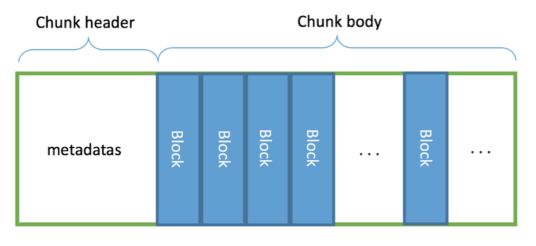
Design of Wamalloc
Chunk is the basic unit that would be transferred between global heap and local heap
Chunk can be divided into several blocks base on its size class
Wamalloc uses two sets of size class: small-span(16B, 24B, 32B,..., 256B), large-span(384B, 512B,..., 32768B, 49152B, 65536B)
Chunk size has a fixed value to simply the design of global heap
Chunk Structure
Notes:
Memory chunk is the basic unit that would be transferred between global heap and local heap, which consists of two parts: a small chunk header and a 64KB chunk body. Chunk body is divided into several memory blocks based on its size class. Obviously, with smaller size class comes more memory blocks. Chunk header stores metadata such as the number of remaining free blocks, its size class and so on.
Wamalloc uses two sets of size class: small-span and large-span.
For the memory requests larger than 64KB, Wamalloc will redirect the request to operating system via system call such as mmap.
In the beginning, all blocks are clean, which indicated by a free pointer.
When a block is freed by the application, it is added to some kind of reuse list according to our wear-leveling policy to be discussed later.
Chunk size has a fixed value to simply the design of global heap.

Slide 9
Local Heap
Local heap is maintained by each thread, which stores information to find the appropriate chunk
Every memory chunk in the local heap can be classified into five categories:
in-use
full
waiting
not-available
clean
Notes:
Local heap is maintained by each thread, which stores information to find the appropriate chunk
Every memory chunk in the local heap can be classified into five categories:
in-use chunk means that when the application makes an allocation request, Wamalloc will first find the appropriate size class, then find the current in-use memory chunk and allocate memory blocks from it.
After several memory requests of a particular size class, a memory chunk may be out of blocks, which is called a full chunk.
Chunks in waiting list of the local heap are called waiting chunks. Waiting chunks are the chunks in a partially allocated state. When a block in a full chunk is freed, it becomes a waiting chunk.
Consider all the things we discussed so far, a typical life cycle of a memory chunk could be first used as in-use chunk, then waiting chunk, and back and forth repeatedly. For the wear-aware purpose, that is not what we expect. Thus we add a wear-count variable to each memory chunk and define an allocation threshold WEAR_LIMIT. When a chunk is first allocated from global heap, its wear-count variable is set to zero. Every time a block is allocated from a chunk, its wear-count variable increases by one. If the wear-count variable of a chunk reaches the predefined allocation threshold, it is no longer available for allocation in this thread, and its state becomes not-available. When all the blocks in a not-available chunk are freed, the chunk is returned back to global heap.
Clean chunk means a chunk without a specific size class,

Slide 10
State Transition of Chunk

Slide 11
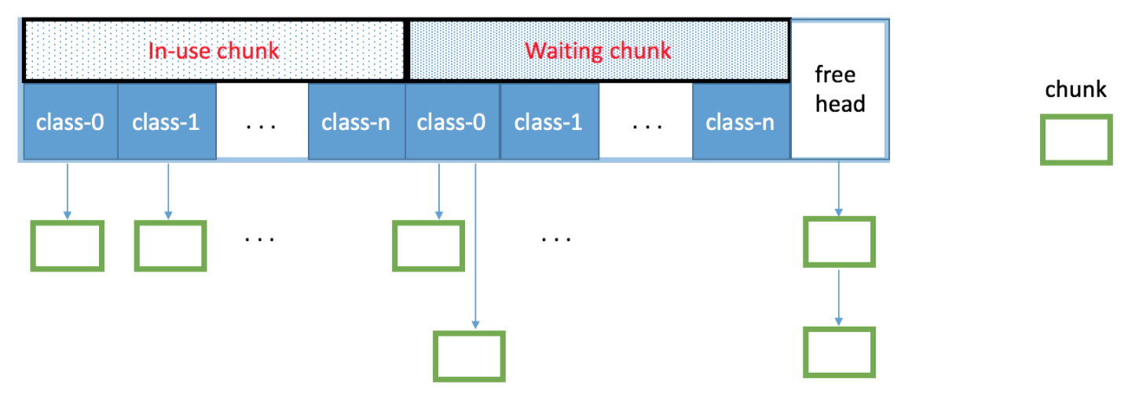
Local Heap Structure

Slide 12
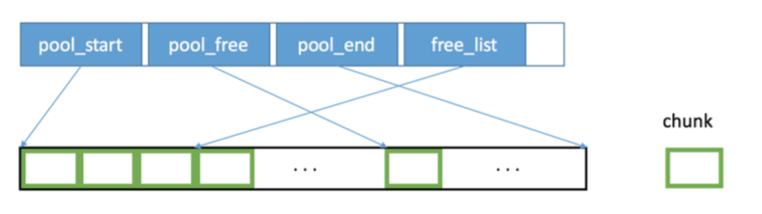
Global Heap
Global heap maintains the whole memory chunks obtained from operating system.
Global heap structure
Notes:
In the beginning, all the chunks are clean, indicated by a free pointer.
After a chunk is returned to global heap, it will be added to some kind of pools related to our wear-leveling policy

Slide 13
Design of Wamalloc(Cont’)
Use different wear-leveling policy in different level:
In block level: FIFO queue is enough
In local heap level:
FIFO queue is enough
Use waiting chunk first, then clean chunk
Add a wear-aware count, if reaches threshold, then not available, ready to return to global heal
In global heap level :
A minheap is used to implement the priority queue to find the chunk of the minimum allocation time.
Chunks are not moved to global pool synchronously, instead, the real action is taken under the ground asynchronously
Notes:
Now we will discuss the wear-leveling policy in different level of Wamalloc in detail. The overall purpose is quite simple: all memory blocks are expected to be allocated evenly.
In block level, it is obviously that Wamalloc should allocate memory block starting from the free pointer first because these memory blocks have never been allocated since this chunk is assigned to its local heap. After a chunk runs out of these blocks, Wamalloc will search the free list to check whether any reusable block is available. In consideration of allocation latency, a simple and fast method is more appropriate in this situation. Thus, we consider the free list as a FIFO queue.
In local heap level , When the current in-use chunk runs out of blocks, a chunk should be chosen as a new in- use chunk based on the wear-leveling policy. Since Clean chunks don’t belong to any size class, they are more flexible than the chunks in waiting chunk list, so we will choose waiting chunk first. With the wear-aware count variable to ensure the upperbound of allocation time, We think FIFO is our best choice in this level.
In global heap level, when the clean chunk is running out, the best wear-leveling policy should return the least allocated chunks so far, so our optimized minheap is used to implement the priority queue to find the chunk of the minimum allocation time. What’s more, Chunks are not moved to global pool synchronously, instead, the real action is taken under the ground asyn- chronously.

Slide 14
Allocation/Deallocation Algorithm of Wamalloc
Allocation:
use size get the size class, then use the size class find the current in-use chunk to allocate block
if full, then look for a waiting/clean chunk
otherwise ask for chunk from global heap
Deallocation:
put the memory block into per-chunk list
If full, then waiting
If clean, then move the chunk to clean list
Notes:
Now I will describe allocation and deallocation algorithm.
When an allocation happens, wamalloc use the parameter size get the size class, then use this size class find the current in-use chunk to allocate block.
If it is a full chunk, then look for a waiting or clean chunk, otherwise ask for chunk from global heap.
When a deallocation happens, wamlloc just put the memory block into a per-chunk list.
If the chunk is full before deallocation, then it becomes to a waiting chunk.
If the chunk is clean after deallocation, it becomes to a clean chunk.

Slide 15
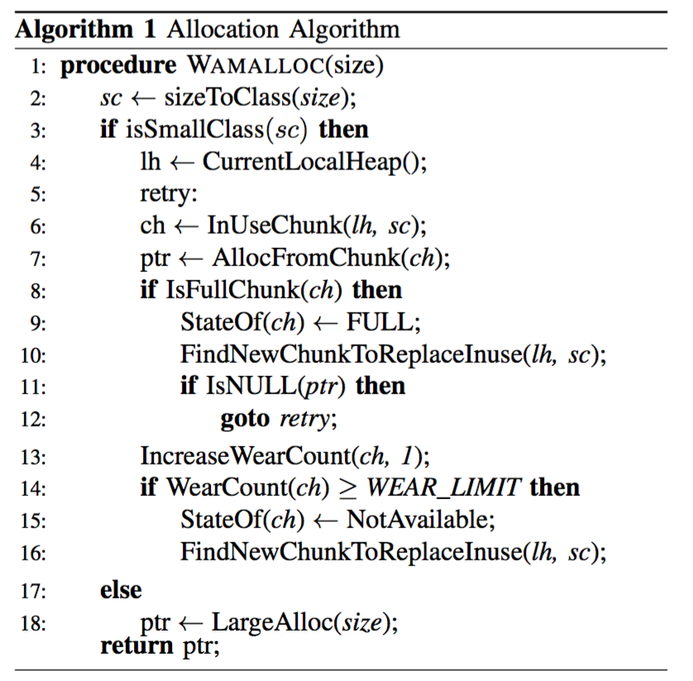
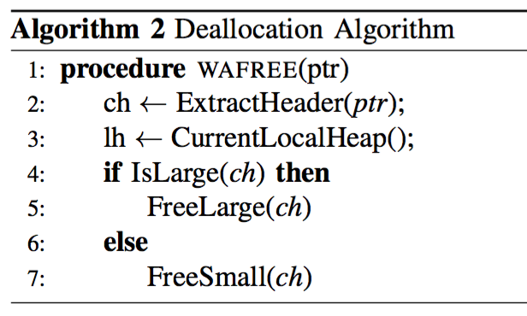
Pseudocode of Wamalloc

Slide 16
Evaluation
We have implemented Wamalloc and evaluated its performance on:
wear-leveling against NVMalloc
total memory usage against NVMalloc
allocation performance against NVMalloc and glibc
Notes:
We have implemented Wamalloc and evaluated its performance on wear-leveling, total memory usage and allocation performance . When we evaluate allocation performance, we also add glibc into comparison to give a baseline.

Slide 17
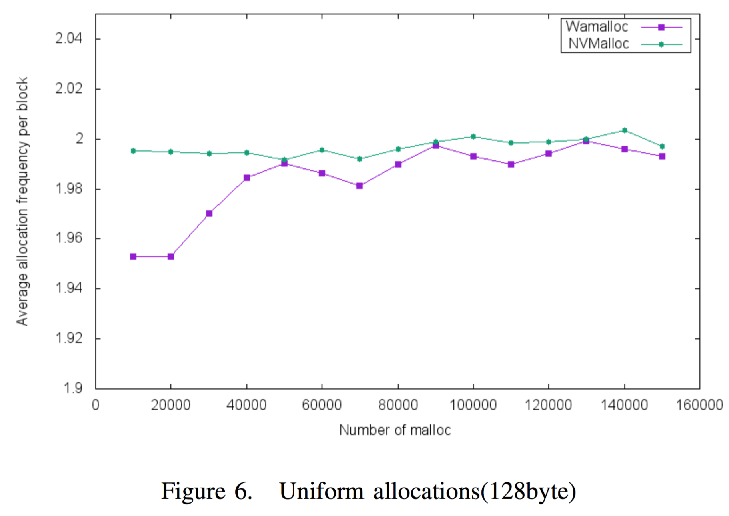
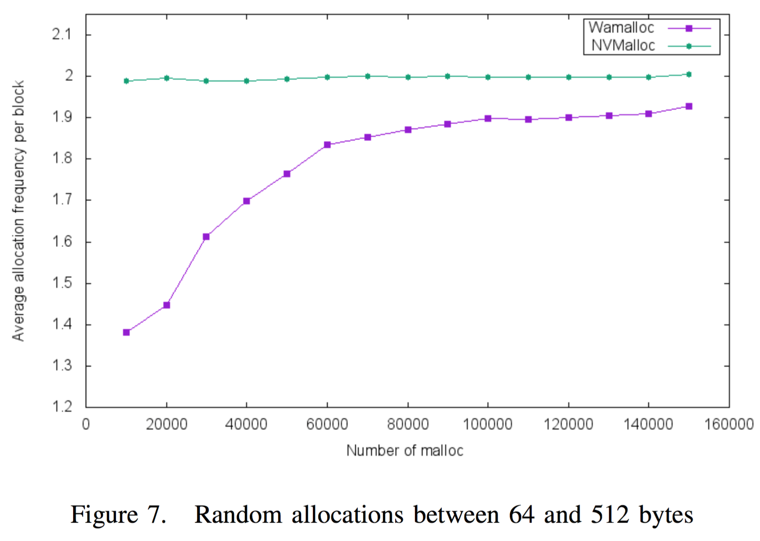
wear-leveling
Wamalloc outperforms other memory allocators
Notes:
First, we evaluate the wear-leveling ability of our allocator using a simple test program under uniform and random allocation and deallocation operations.
These two Figures show the result of wear-leveling in terms of average allocation frequency per block under uniform allocation of 128 bytes and random allocation between 64 and 512 bytes. Since Wamalloc use a more elaborate and accurate wear-leveling policy than NVMalloc, it is expected that Wamalloc performs better than NVMalloc.

Slide 18
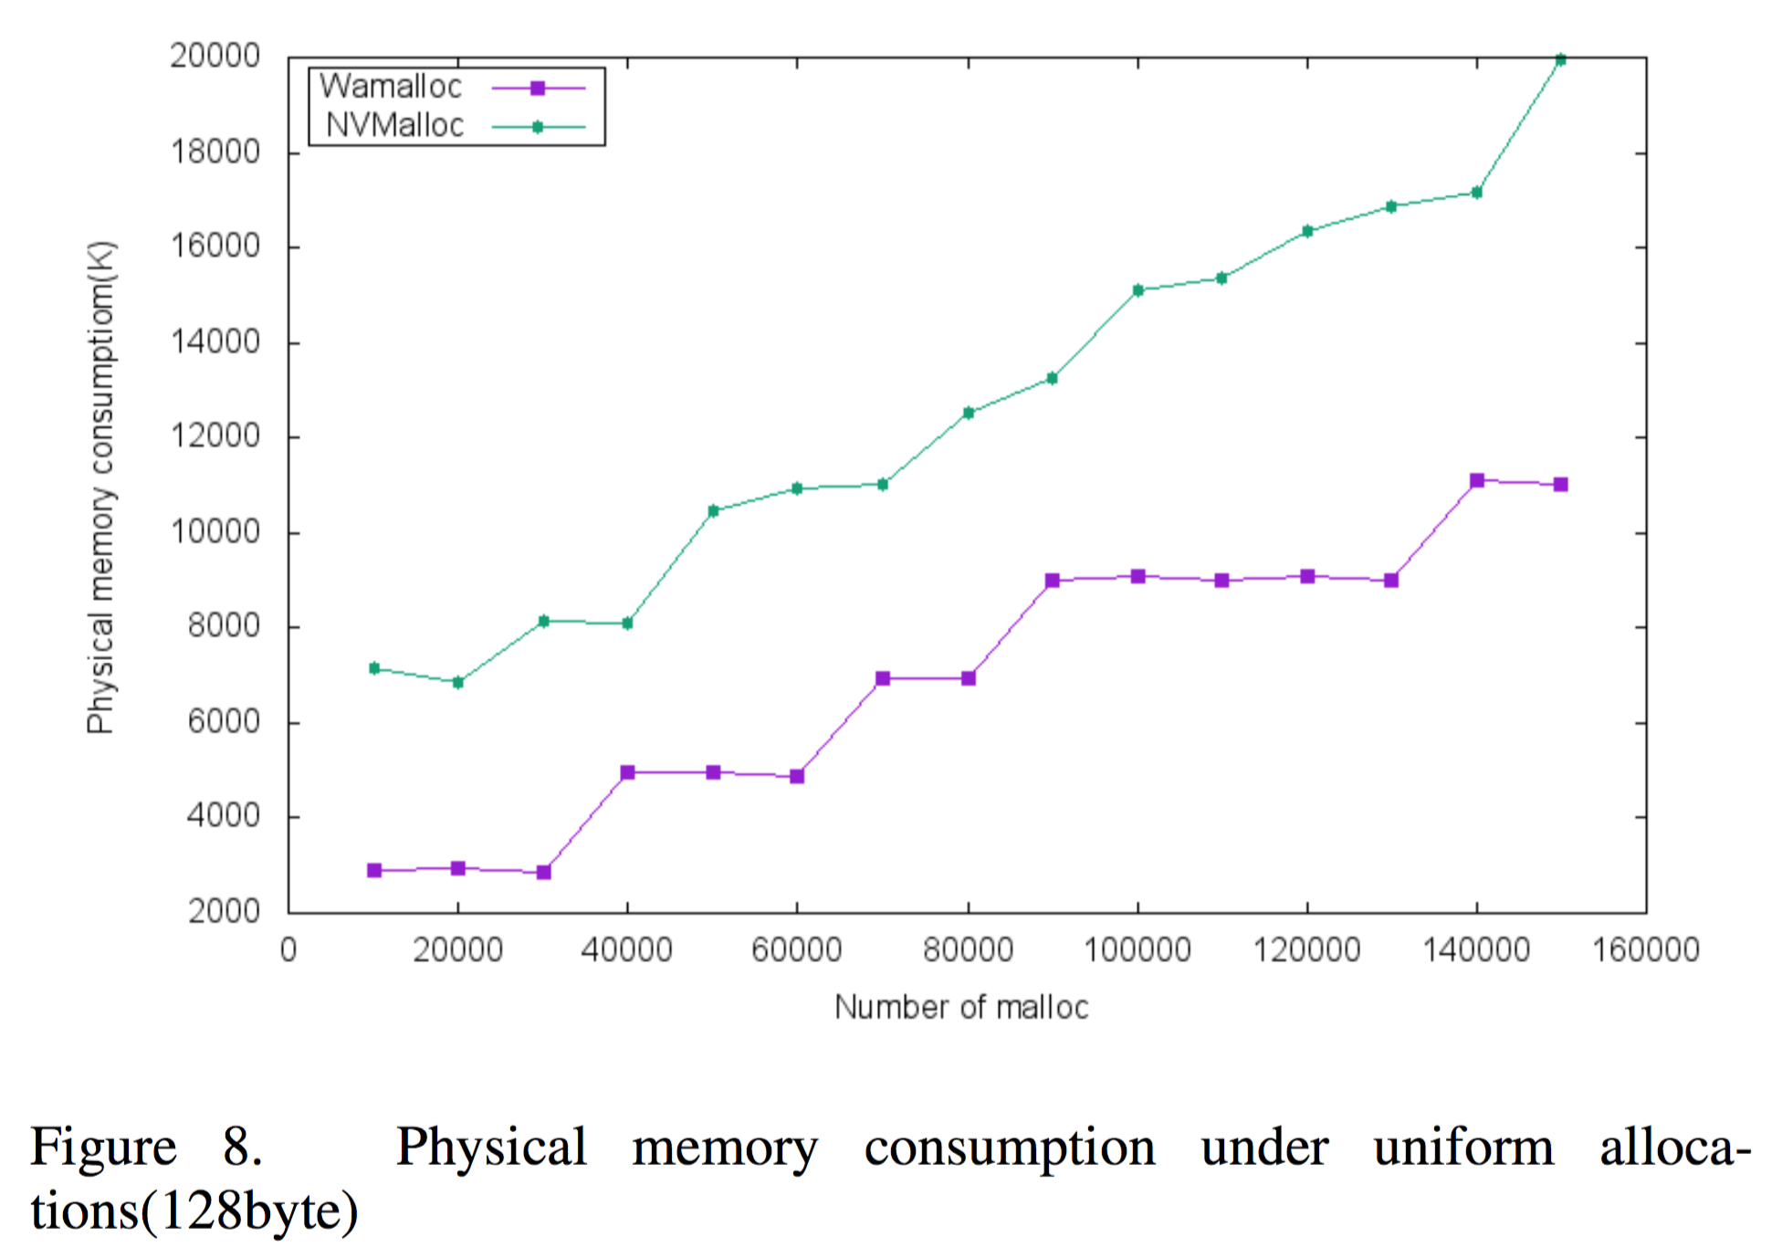
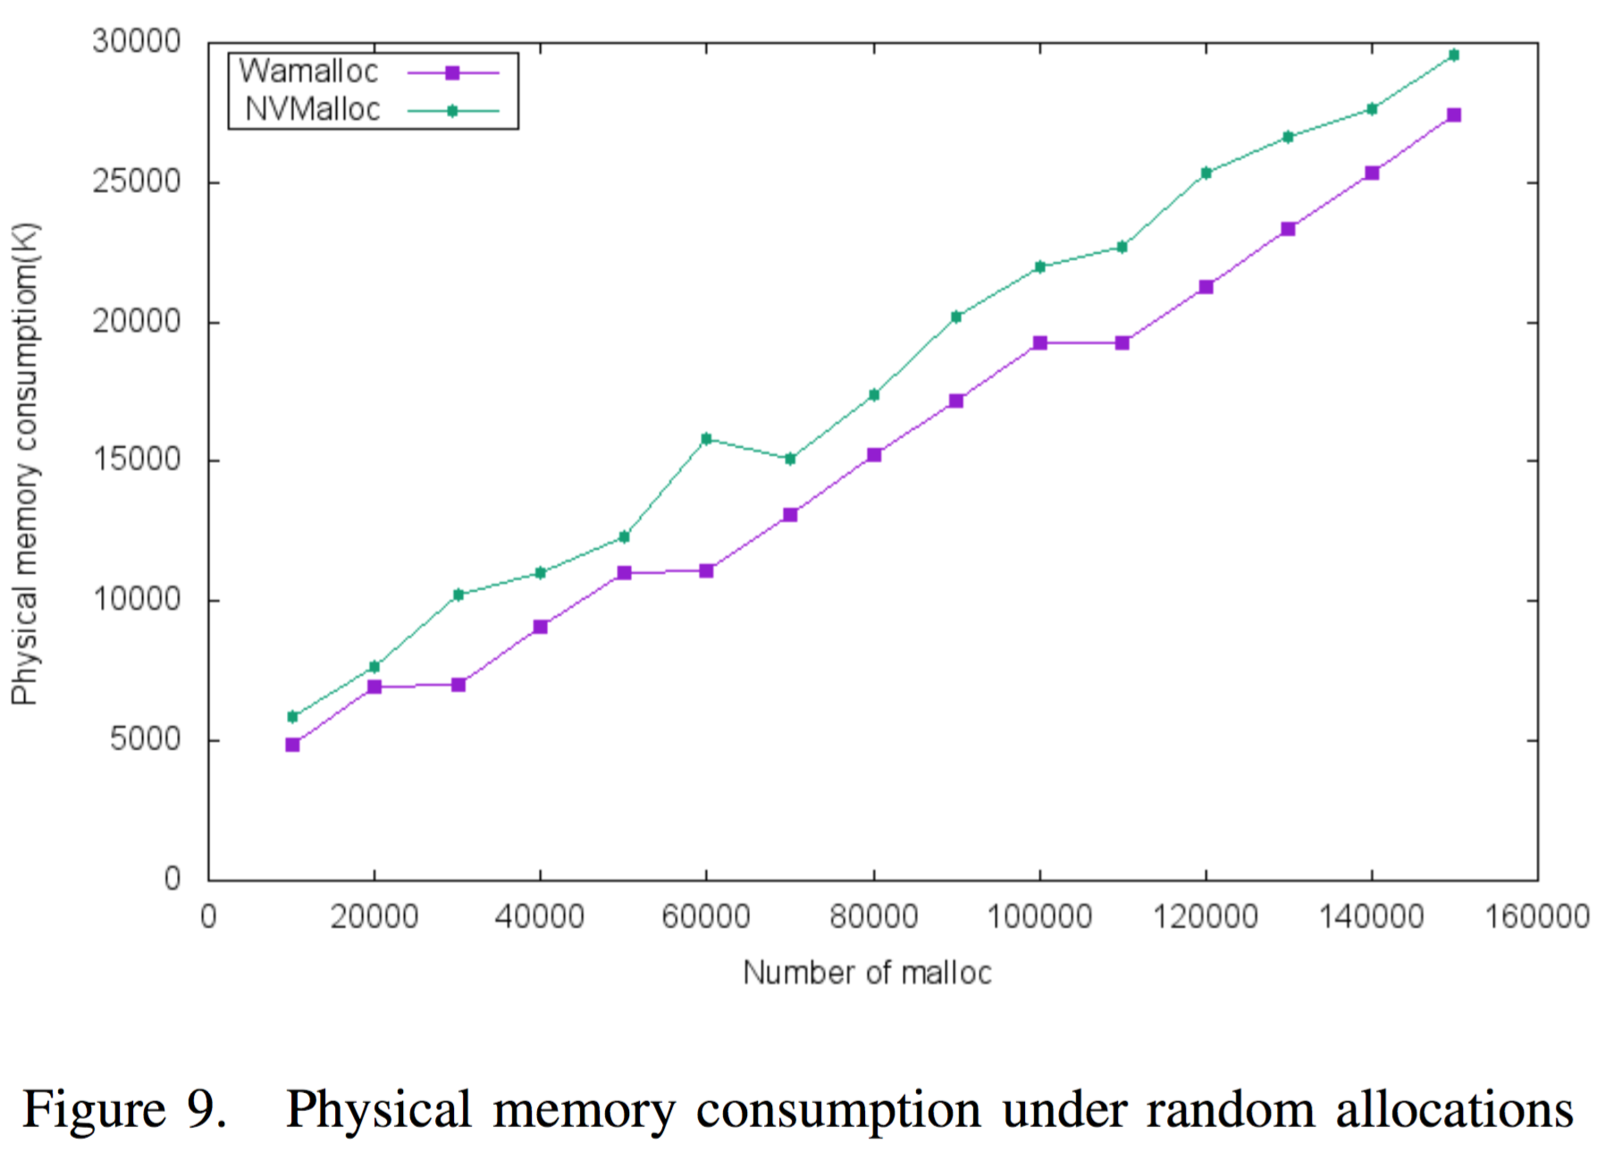
total memory usage
Wamalloc outperforms other memory allocators
Notes:
However, it is meaningless to compare the average allocation frequency without considering the physical memory consumption. A simple allocator that allocates every memory block just once and never use that memory again could make the average allocation frequency per block to be 1, while at the meantime it consumes plenty of physical memory, causing it to be a useless allocator. Thus, next we are also supposed to measure the memory consumption of above evaluations under uniform and random allocation.
Evaluation shows that Wamalloc is more economic in physical memory usage than NVMalloc.

Slide 19
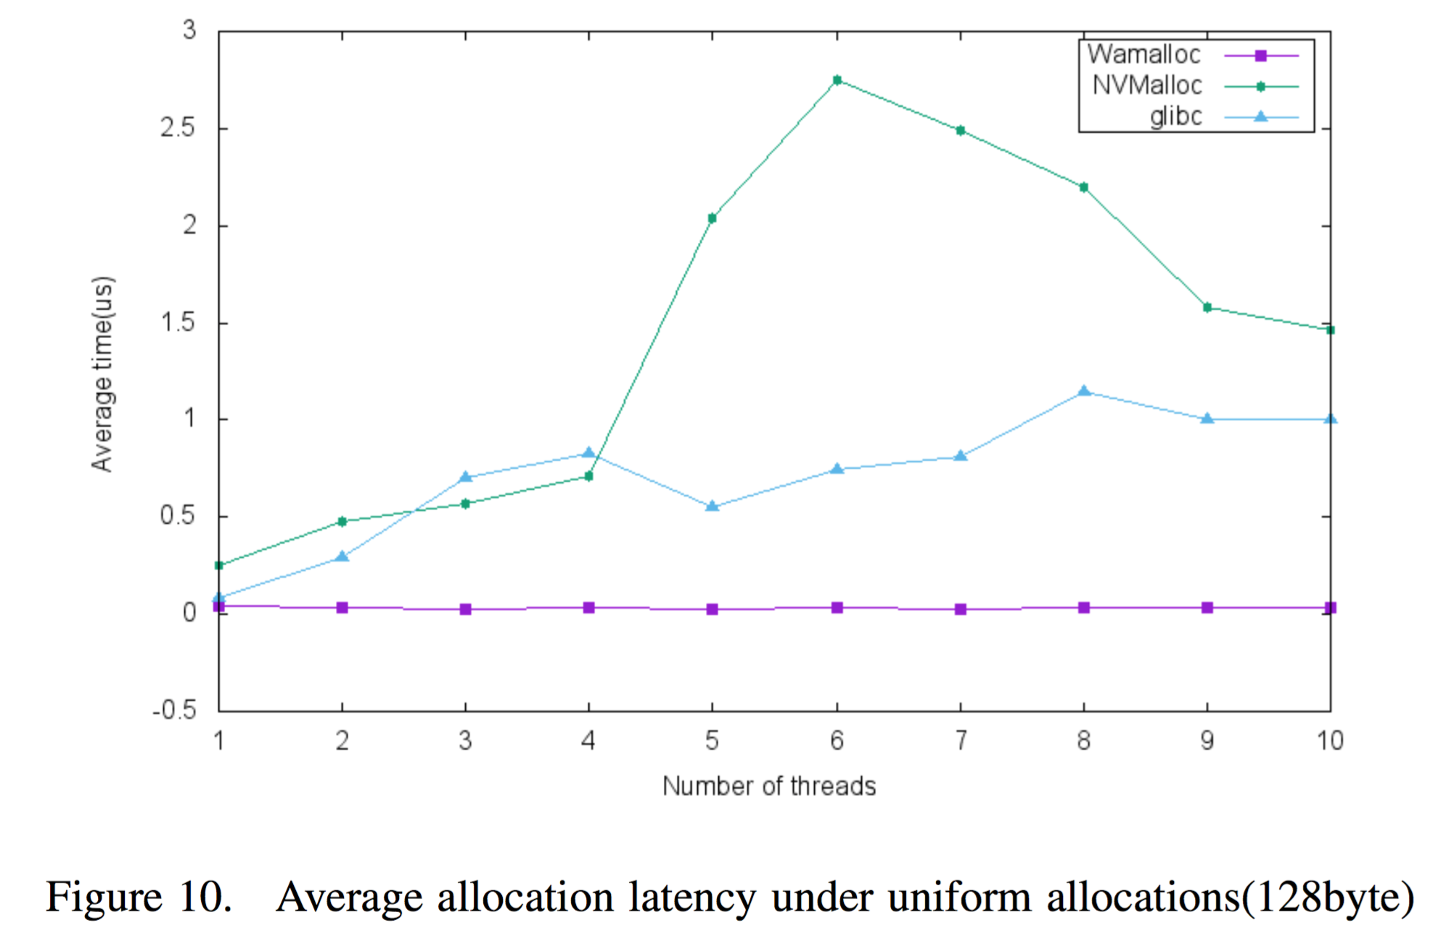
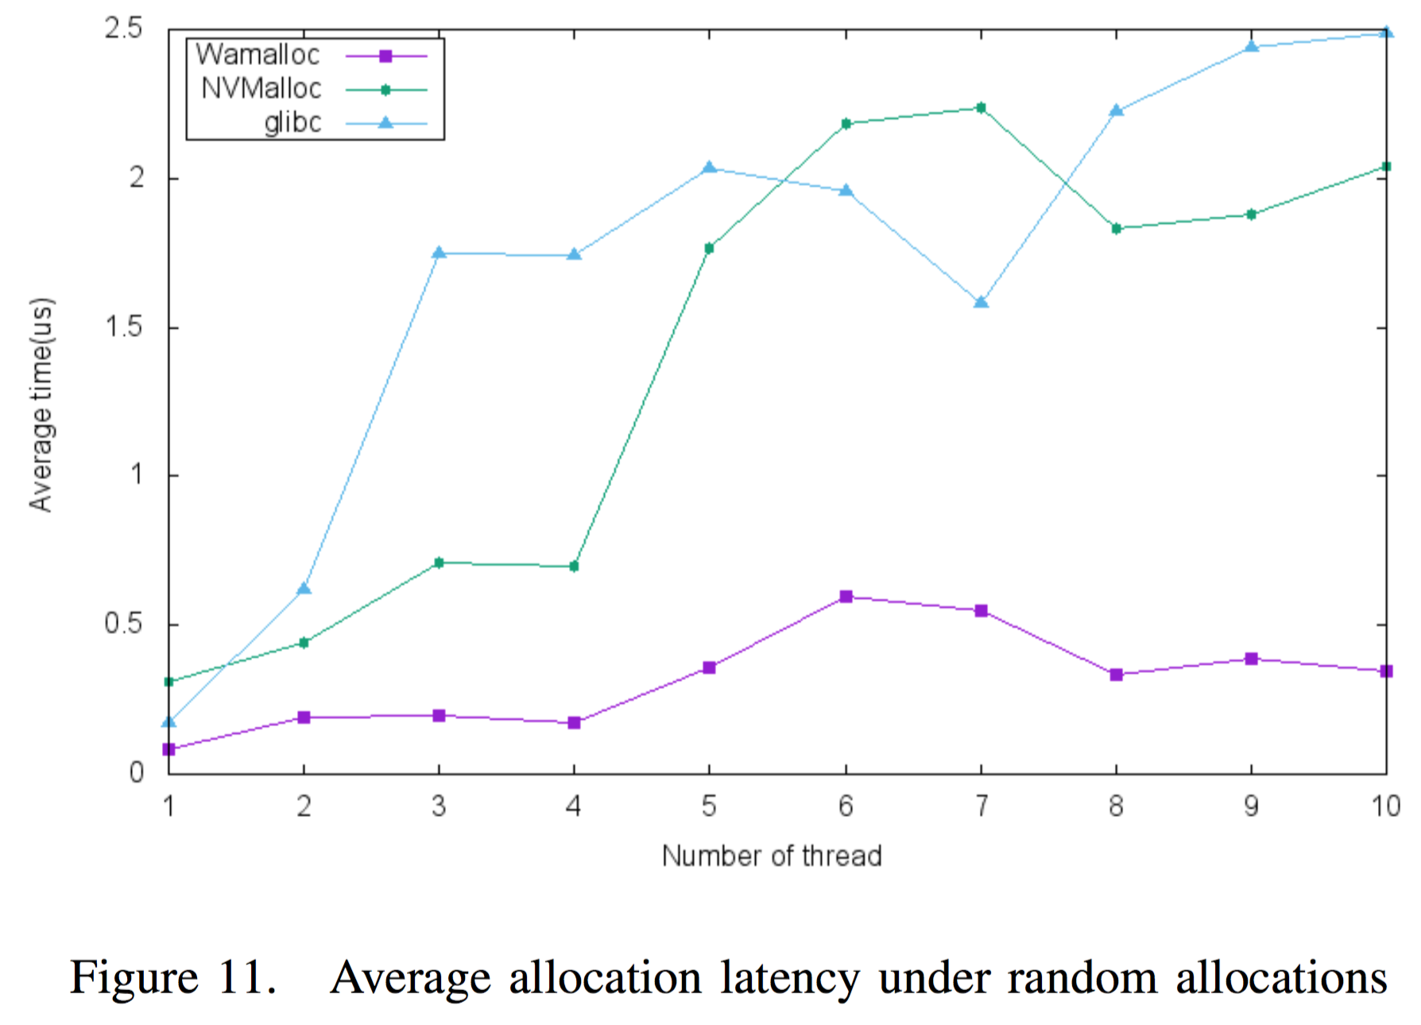
allocation performance
Wamalloc outperforms other memory allocators
Notes:
We compare the allocation performance of Wamalloc against different allocators, which is a crucial metric since it will affect the overall performance of a program.
we evaluate the average allocation latency as the number of parallel threads increases under the workload of uniform and random allocation. Since Wamalloc uses a thread-cache structure and has a very short critical path using locks as few as possible, the average allocation latency should be little related to the number of threads. These expectations are confirmed by the result of our evaluations. From the result we can verify that Wamalloc outperforms both glibc and NVMalloc under different workloads.

Slide 20
Conclusion
In this paper, we observe the fact that no NVM allocators at the time of writing can provide both an accurate wear-leveling policy and a good allocation performance simultaneously.
Based on the observation, we propose an efficient wear-aware NVM allocator, Wamalloc, which uses a thread-cache memory architecture causing nearly no lock contention in critical path, and an elaborate hybrid wear-leveling policy to improve the lifetime of NVM.
The experimental results show that Wamalloc outperforms NVMalloc in terms of wear-leveling policy, total memory consumption and allocation performance.

Slide 21
Thank you
Q & A

